Slide 1




Credit and Debit Banking
Presented By Group 6
17 -July-2025

Slide 2


MEET THE TEAM
01
Ms. Aishwarya Patil
02
Mr. Darshan Pathak
03
Mr. Harish Landge
04
Ms. Pallavi Mehra
05
Mr. Shafiq Ansari
06
Mr. Sumeet Bagade

Slide 3

Introduction
01
Agenda
02
Scope
03
Overview
04
KPI’s
05
Insights

Slide 4

Introduction
The current dataset highlights a stable transaction pattern across branches and banks, with clear opportunities to focus on high-value customers and sustain healthy branch-level performance. Monitoring seasonal trends, large individual transactions, and any negative cash flow signals will help maintain operational resilience and customer trust.

Slide 5


Scope
This project analyzes debit and credit transactions to:
Identify key customers and high-value transactions
Evaluate monthly trends and branch-wise cash flow
Detect outliers or negative balances
Provide clear, actionable insights to support branch performance, customer retention, and risk monitoring

Slide 6


Overview
This project provides a detailed analysis of a large banking dataset containing debit and credit transactions across multiple branches, customers, and banks. The goal is to uncover meaningful insights about transaction trends, customer behavior, branch performance, and overall cash flow.

Slide 7




Tools
Excel
Power Bi Tableau MY SQL
Project Management Tools

Slide 8




Slide 9

KPI’s 01
Excel

Slide 10
KPI’s 02
Tableau

Slide 11
KPI’s 03
•
•
PowerBi
•

Slide 12
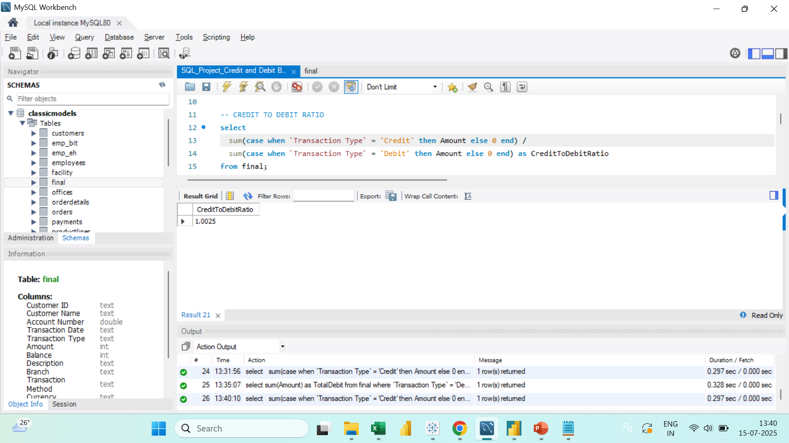
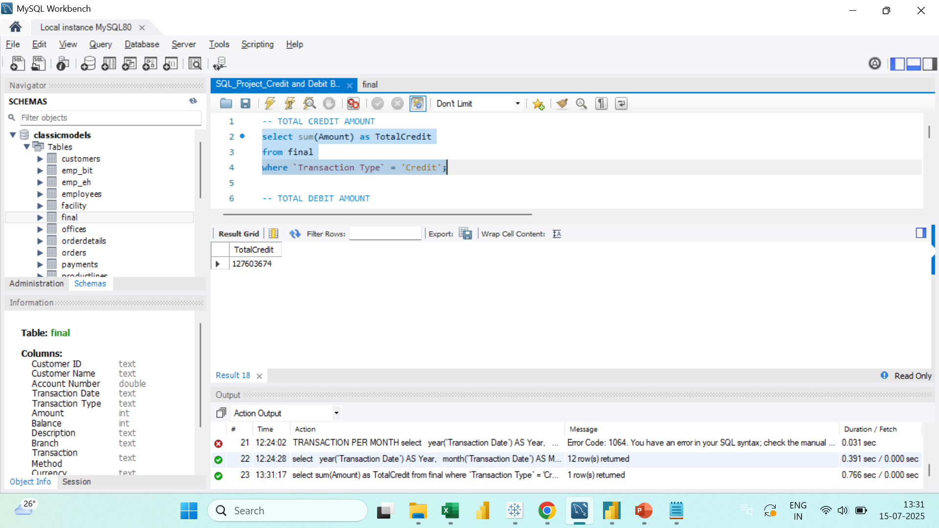
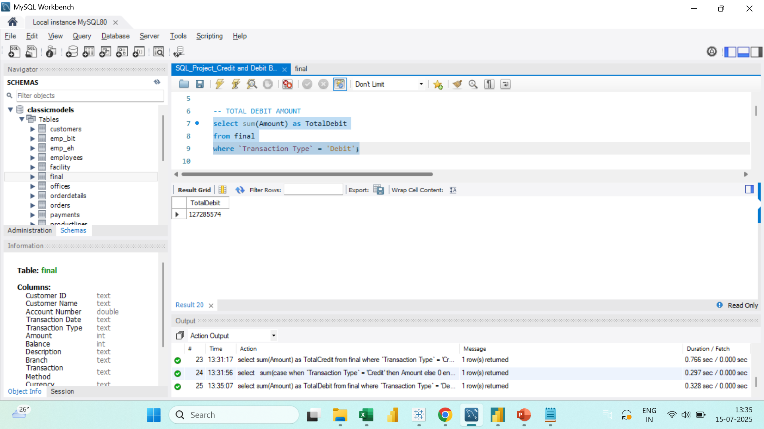

KPI’s 04
MY SQL

Slide 13


Slide 14
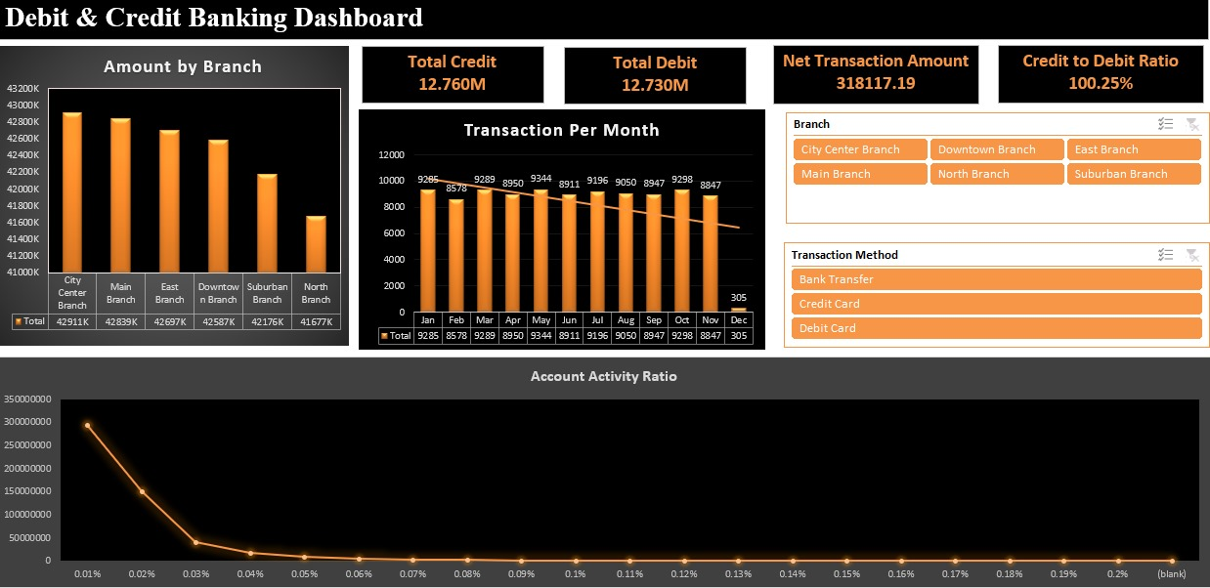
EXCEL DASHBOARD

Slide 15
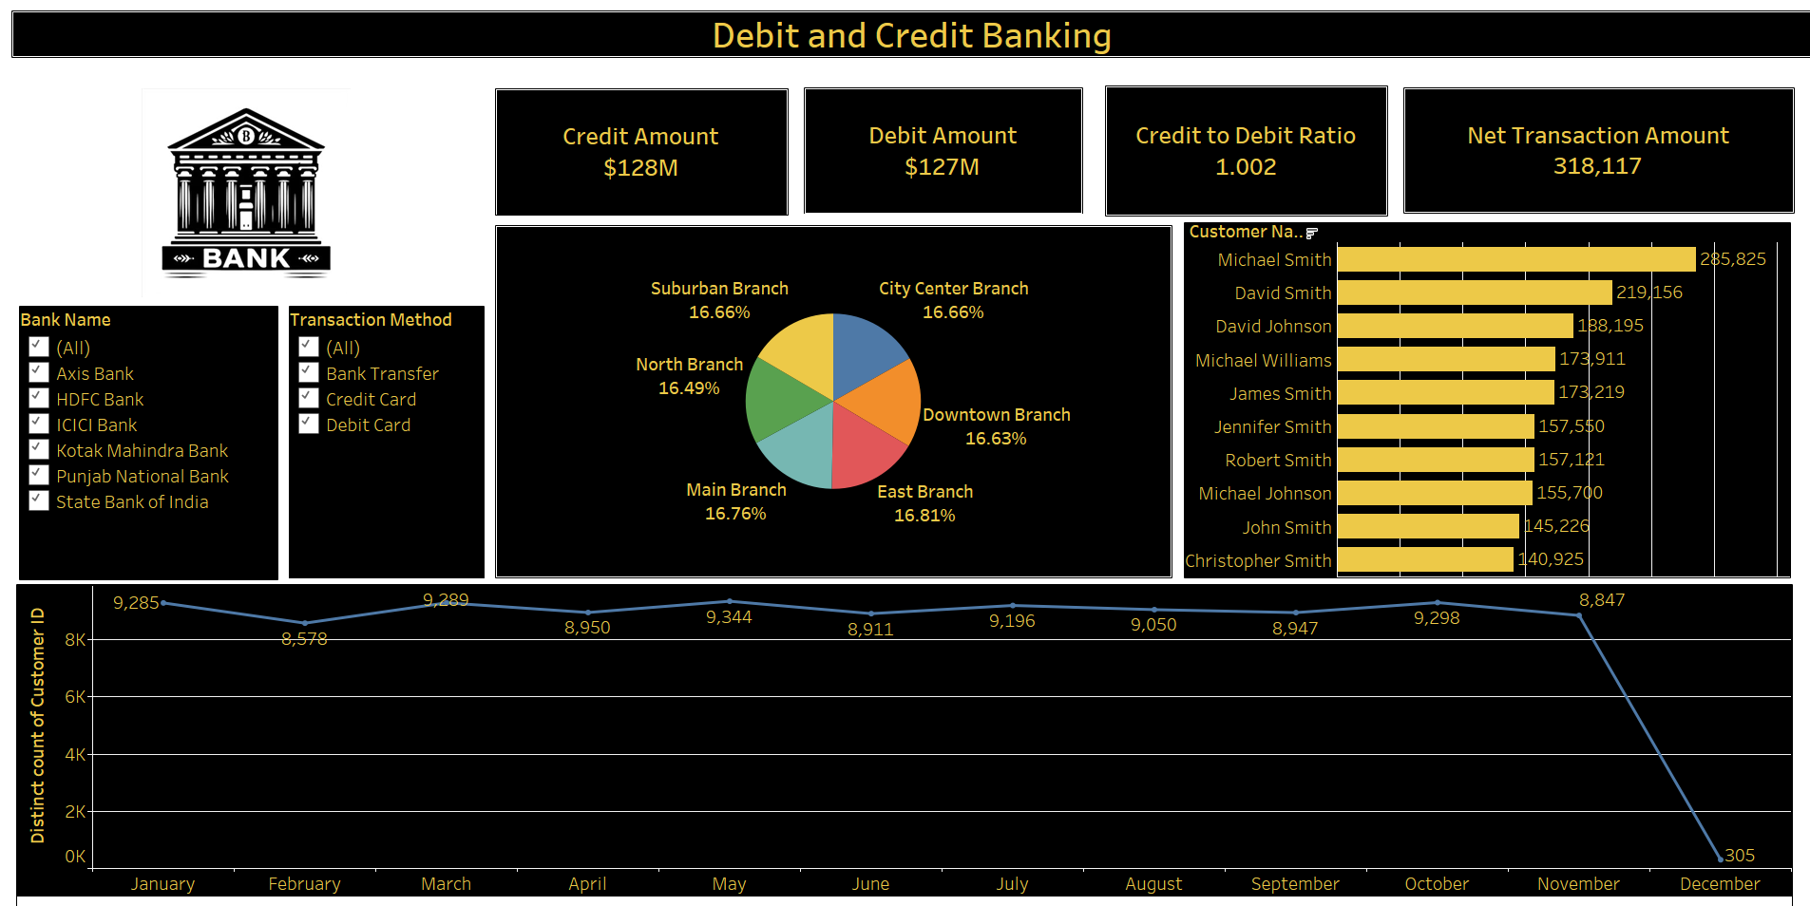
TABLEAU DASHBOARD

Slide 16
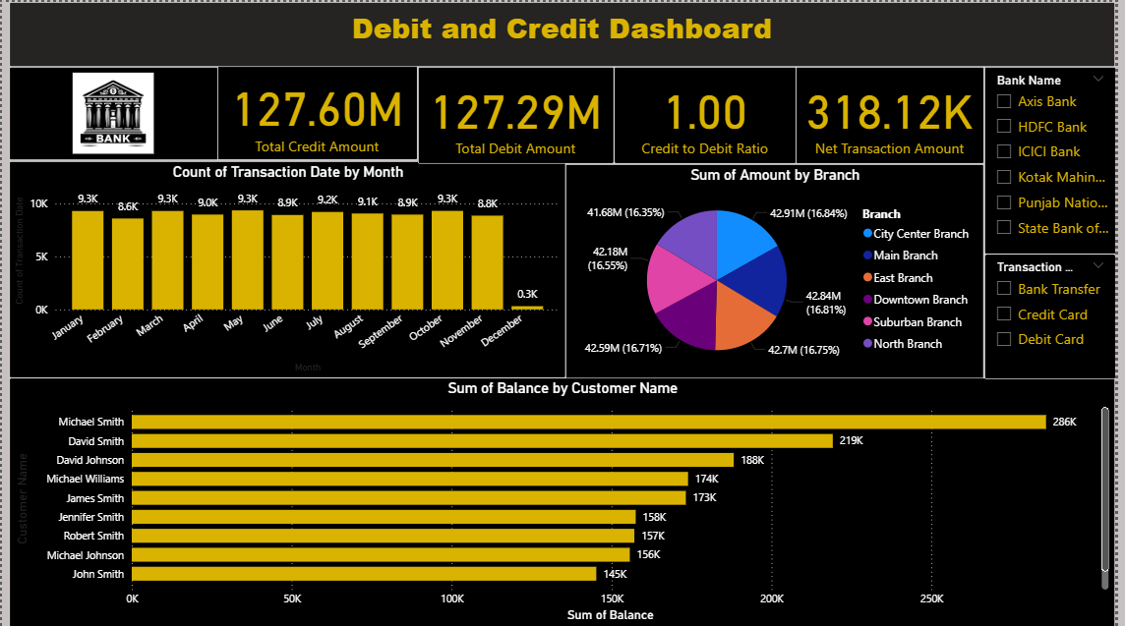
Power BI DASHBOARD

Slide 17
My SQL Dashboard
TOP 10 CUSTOMERS BY BALANCE
select `Customer Name`, sum(Balance) as TotalBalance from final group by `Customer Name` order by TotalBalance desc limit 10;
TRANSACTION BY BRANCH
select Branch, sum(Amount) as TotalTransactionAmount from final
group by Branch;
TRANSACTION PER MONTH
select year(`Transaction Date`) AS Year, month(`Transaction Date`) AS Month, COUNT(*) AS TransactionsPerMonth from final group by Year, Month order by Year, Month;
ACCOUNT ACTIVITY RATIO
select `Customer ID`, count(*) / avg(Balance) as AccountActivityRatio from final group by `Customer ID`;

Slide 18
Insights
Consistent Monthly Activity:
Overall transaction volumes remain steady throughout the year, with a noticeable decline in December. This seasonal dip likely reflects reduced banking activity during the holiday period.
Even Branch Contribution:
The analysis shows that funds are deposited almost equally across all branches. This balanced distribution indicates no single branch significantly dominates cash inflows.
Notable Customers:
Michael Smith is identified as the customer with the highest total credits, while David Smith records the highest total debits. These individuals represent key customers with significant account movements
Highest Individual Transaction:
Anthony Whitaker holds the record for the largest single transaction in this dataset, valued at $4,999.90. This suggests a high-value transaction worth monitoring for relationship management or potential upselling opportunities.
Bank Cash Flow Position:
Five out of six banks analyzed maintain a positive net cash flow, indicating stable liquidity. Punjab National Bank shows a negative net position of –897,174, which may require closer examination but does not pose an immediate systemic risk.

Slide 19

















Prepared By Group6

